Slide 1

Earthquake Impact Predictor
Creation and presentation by ~Harshit Mohan Srivastava

Slide 2
Problem Statement
Earthquakes are unpredictable natural disasters that can cause severe damage to life and infrastructure. Traditional alert systems often rely on manual interpretation of seismic parameters, which delays timely response and reduces effectiveness in disaster preparedness. There is a critical need for an automated, accurate, and interpretable system that can quickly assess seismic data (magnitude, depth, CDI, MMI, and SIG) and predict the potential impact level.
This project addresses the challenge by leveraging machine learning to build a predictive model that classifies earthquake events into alert zones (green, yellow, orange, red) with high accuracy. The goal is to provide a fast, user-friendly tool that enhances situational awareness and supports early warning systems for communities and disaster management authorities.

Slide 3
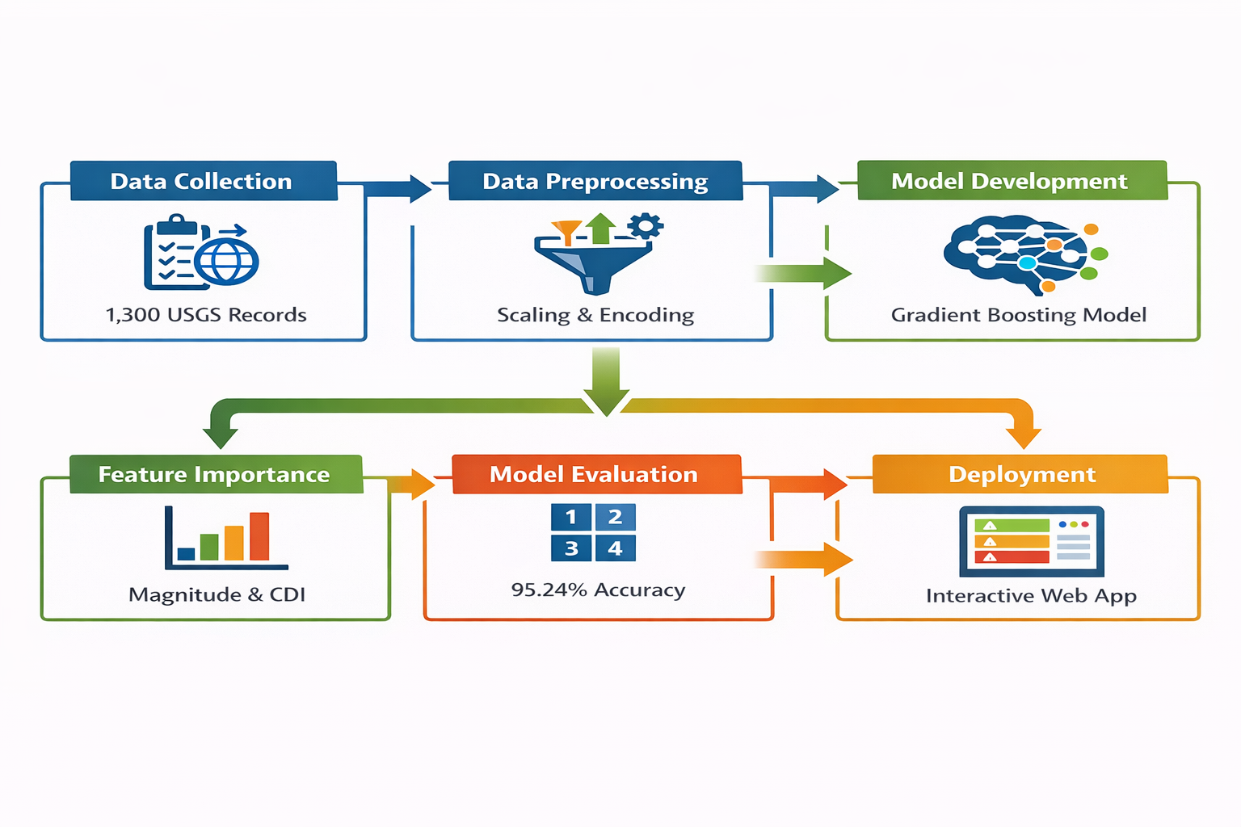
Methodology

Slide 4
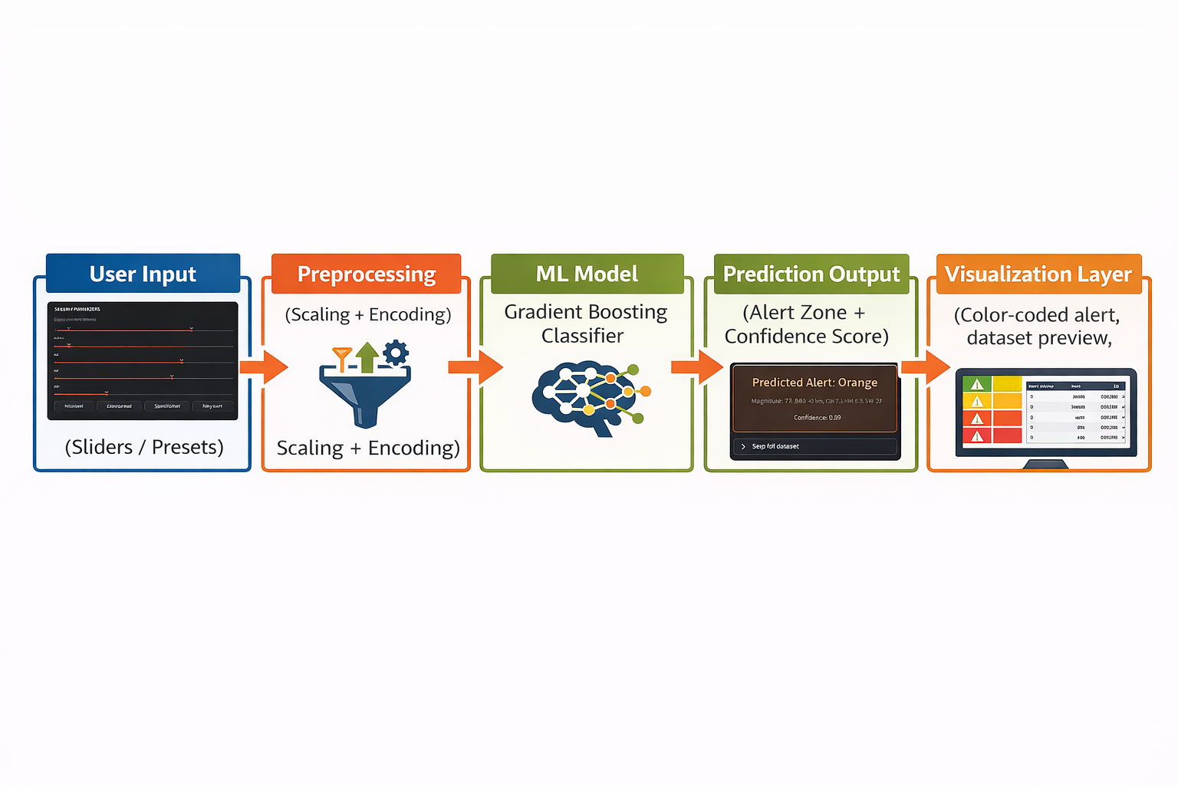
Project Flow Diagram

Slide 5
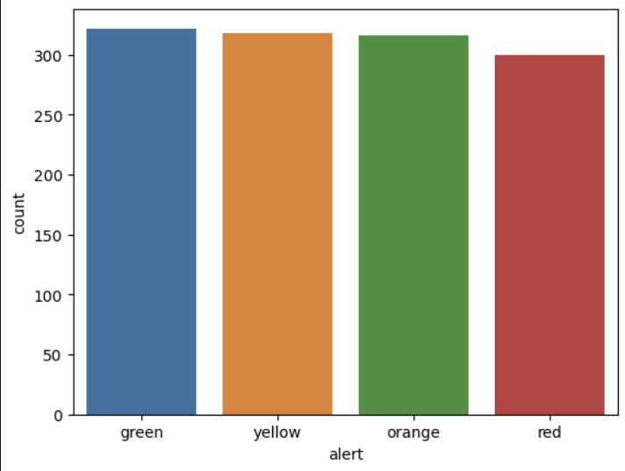
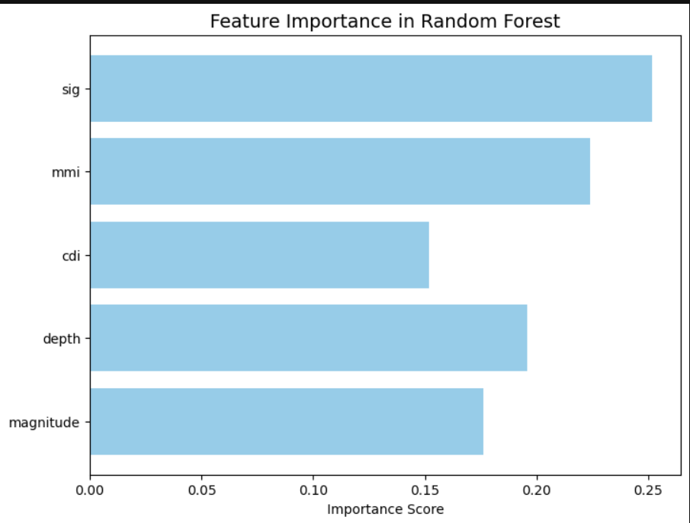
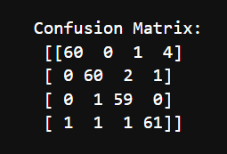
Graphs and charts
Class Balance
Model Performance
Feature Importance

Slide 6
Tech Stack
Layer | Tools & Technologies Used
Data Handling | Pandas, NumPy – for dataset loading, cleaning, preprocessing, and feature scaling.
Modelling | Scikit-learn – Gradient Boosting Classifier, Label Encoding, evaluation metrics.
Visualization | Matplotlib, Seaborn, Streamlit native charts – for feature importance, distributions, confidence plots.
Frontend/UI | Streamlit – interactive web app with sliders, number inputs, preset buttons, and styled prediction cards.
Deployment | Streamlit cloud – for deploying the app online to make it accessible to everyone on internet.
Version Control | Git/GitHub – for project tracking and collaboration.
Environment | Python 3.11.7, Virtual Environment (venv).

Slide 7

Solutions
Automated Prediction – Built a Gradient Boosting Classifier to classify earthquakes into alert zones with 95.24% accuracy.
Interactive Web App – Deployed a Streamlit interface with sliders, presets, and real-time predictions with confidence scores..
Transparency & Usability – Added dataset preview, download option, and feature importance analysis for interpretability and user trust.

Slide 8
Conclusion
The project demonstrates how Machine Learning can automate earthquake alert prediction, reducing reliance on manual interpretation.
The Gradient Boosting Classifier achieved 95.24% accuracy, proving reliable classification of seismic events into alert zones.
The Streamlit app provides a user friendly interface with real time predictions, confidence scores, and dataset transparency.
The solution enhances disaster preparedness and awareness, with potential for future integration of real-time seismic feeds and cloud development.

Slide 9

Thank You

